Slide 1
Knapsack Problem

Slide 2
Knapsack Problem
Given a set of items, each with a weight and a value, determine a subset of items to include in a collection so that the total weight is less than or equal to a given limit and the total value is as large as possible.

Slide 3
Greedy Strategy
Greedy Criterion I
Items are arranged by their values , here the item with
maximum value is selected first
Greedy Criterion II
Items arranged by their weights, items with lightest weight is selected first
Greedy Criterion III
Items are arranged by certain ratio (ratio of value over weight), here the selection proceeds from maximum ratio to minimum one

Slide 4
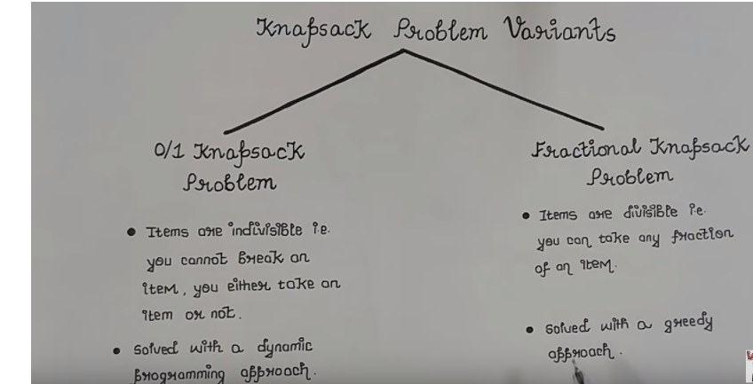

Slide 5
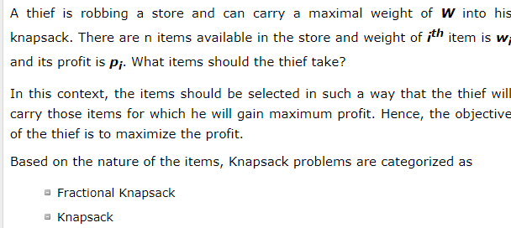
Problem Scenario

Slide 6
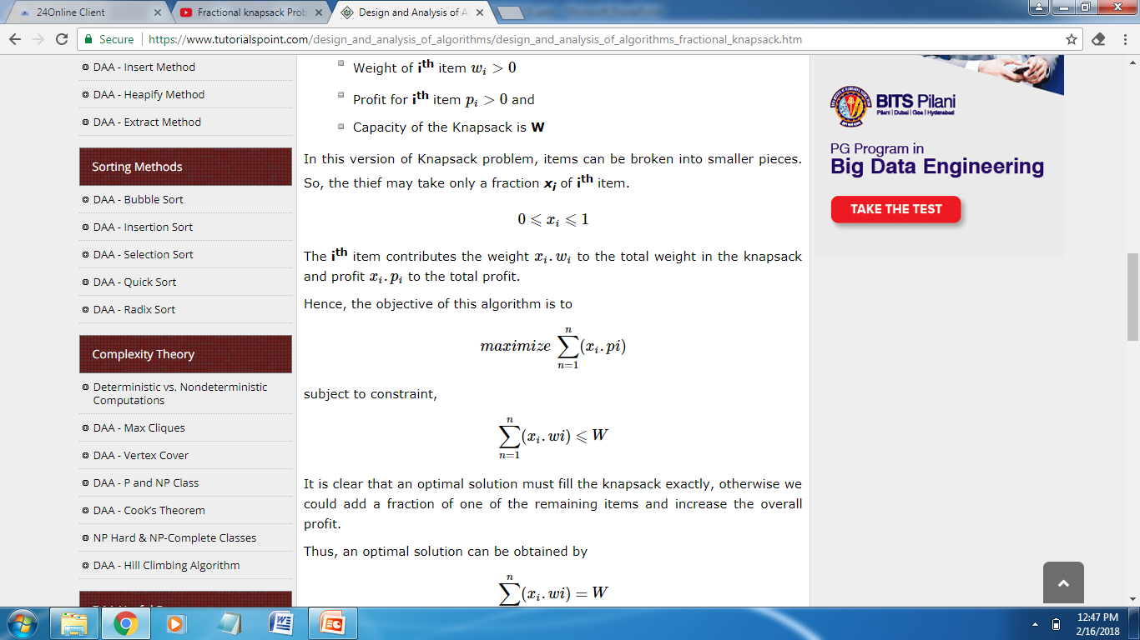
Problem
N number of items
Wi. . . . . . . . Wn Weight associated with items
Pi . . . . . . . . Pn Profit associated with items
Knapsack with certain capacity

Slide 7
Applications
Finding the least wasteful way to cut raw materials
portfolio optimization
Cutting stock problems

Slide 8
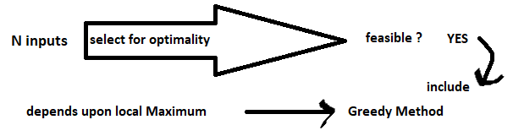
Greedy Method
The Greedy Method is one of the strategies or approaches for solving optimization problems. A problem that requires either minimum or maximum results is known as an optimization problem.

Slide 9
Knapsack problem greed by Weight
1.First initialize two array profit and weight and then profit and weight of item stored into the array respectively.
2.Now enter the capacity of knapsack bag.
3.As we are solving knapsack using greed by weight so we will first sort the array of weight in ascending order.
4.Then we will iterate from starting of weight array by considering input one at a time, checking to see if it can be included in the set of values which give an optimal solution and then check if it is feasible solution or not. if it is feasible solution then include into the bag otherwise discarded.
5.We will repeat the above step till we iterate whole array or items we have included do not surpasses our capacity.

Slide 10
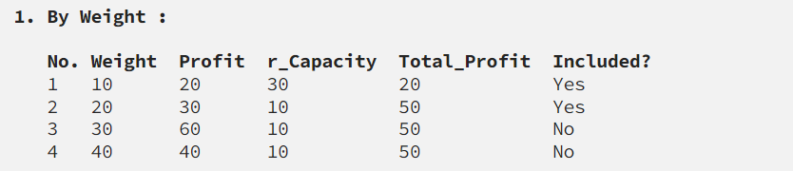
Example :
weight[] = {10,20,30,40}
profit[] = {20,30,60,40}
profit/weight = {2,1.5,2,1}
Knapsack_Capacity = 40
Total_Profit = 0

Slide 11
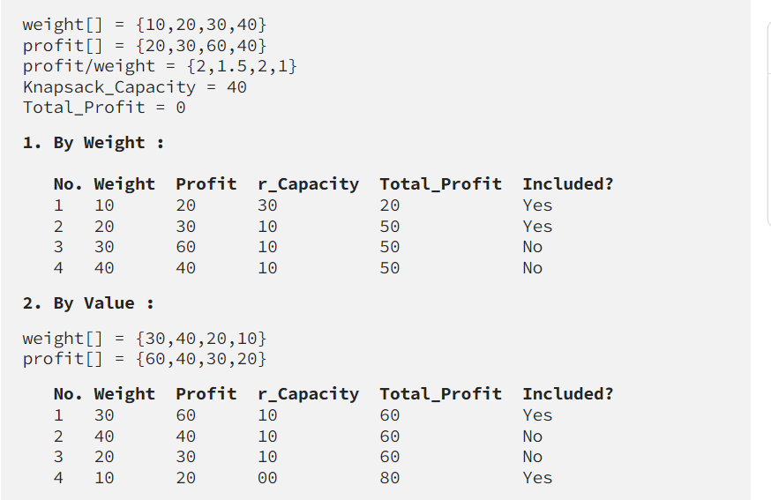

Slide 12
#include <iostream>
#include <climits>
using namespace std;
int knapSack(int v[], int w[], int n, int W) {
if (W < 0)
return INT_MIN;
if (n < 0 || W == 0)
return 0;
int in = v[n] + knapSack(v, w, n - 1, W - w[n]);
int ex = knapSack(v, w, n - 1, W);
return max (in, ex);
}
int main() {
int v[] = { 10, 20, 30, 40, 60, 70 };
int w[] = { 1, 2, 3, 6, 7, 4 };
int W = 7;
int n = sizeof(v) / sizeof(v[0]);
cout << "Knapsack value is " << knapSack(v, w, n - 1, W);
return 0;
}

